Slide 1


2057 Demographic Methods
Practical 4:
Life Tables 2
24/10/2025

Slide 2
1. Athens in 1981, female population
x | _{n}m_{x} | n | _{n}a_{x} | _{n}q_{x} | _{n}p_{x} | l_{x} | _{n}d_{x} | _{n}L_{x} | T_{x} | e_{x}
0 |  |  |  |  |  | 100,000
1 |  |  |  |  |  | 98,179
5 |  |  |  |  |  | 97,884
10 |  |  |  |  |  | 97,752 |  |  |  | 66.385
15 |  |  |  |  |  | 97,658
20 |  |  |  |  |  | 97,512
25 |  |  |  |  |  | 97,313
30 |  |  |  |  |  | 97,068
35 |  |  |  |  |  | 96,761
40 |  |  |  |  |  | 96,343
45 |  |  |  |  |  | 95,721
50 |  |  |  |  |  | 94,669
55 |  |  |  |  |  | 92,945
60 |  |  |  |  |  | 90,131
65 |  |  |  |  |  | 85,492
70 |  |  |  |  |  | 77,598
75 |  |  |  |  |  | 65,075
80 |  |  |  |  |  | 47,402
85+ |  |  |  |  |  | 27,701

Slide 3
1. Athens in 1981, female population
x | _{n}m_{x} | n | _{n}a_{x} | _{n}q_{x} | _{n}p_{x} | l_{x} | _{n}d_{x} | _{n}L_{x} | T_{x} | e_{x}
0 |  | 1 | 0.3 |  |  | 100,000
1 |  | 4 | 0.4 |  |  | 98,179
5 |  | 5 | 0.5 |  |  | 97,884
10 |  | 5 | 0.5 |  |  | 97,752 |  |  |  | 66.385
15 |  | 5 | 0.5 |  |  | 97,658
20 |  | 5 | 0.5 |  |  | 97,512
25 |  | 5 | 0.5 |  |  | 97,313
30 |  | 5 | 0.5 |  |  | 97,068
35 |  | 5 | 0.5 |  |  | 96,761
40 |  | 5 | 0.5 |  |  | 96,343
45 |  | 5 | 0.5 |  |  | 95,721
50 |  | 5 | 0.5 |  |  | 94,669
55 |  | 5 | 0.5 |  |  | 92,945
60 |  | 5 | 0.5 |  |  | 90,131
65 |  | 5 | 0.5 |  |  | 85,492
70 |  | 5 | 0.5 |  |  | 77,598
75 |  | 5 | 0.5 |  |  | 65,075
80 |  | 5 | 0.5 |  |  | 47,402
85+ |  |  |  |  |  | 27,701
1. Use x to calculate n
2. Assume corresponding values for ₁a₀ , ₄a₁ , and ₅a_{x}.

Slide 4
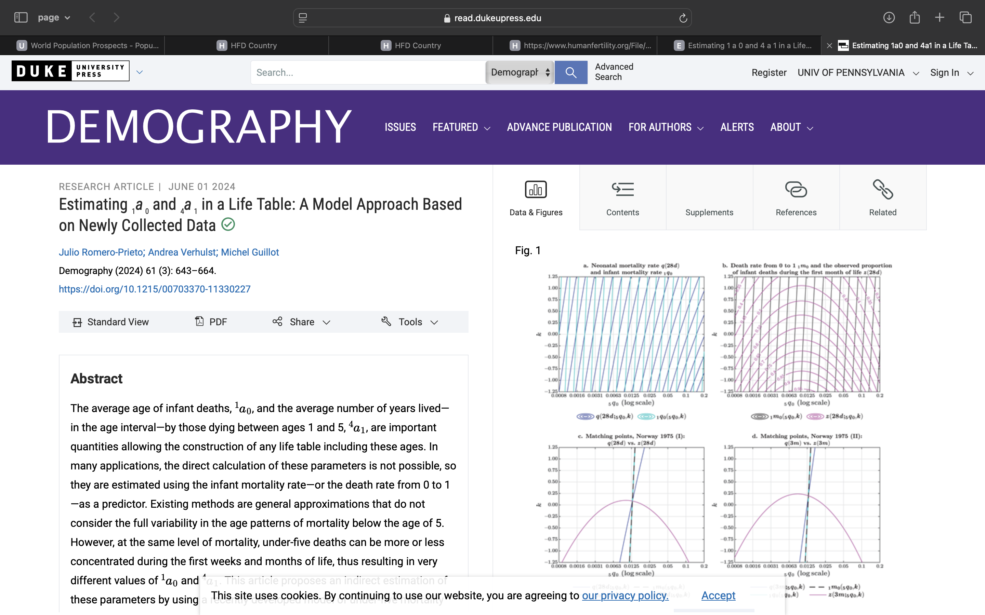
1. Athens in 1981, female population
https://doi.org/10.1215/00703370-11330227

Slide 5
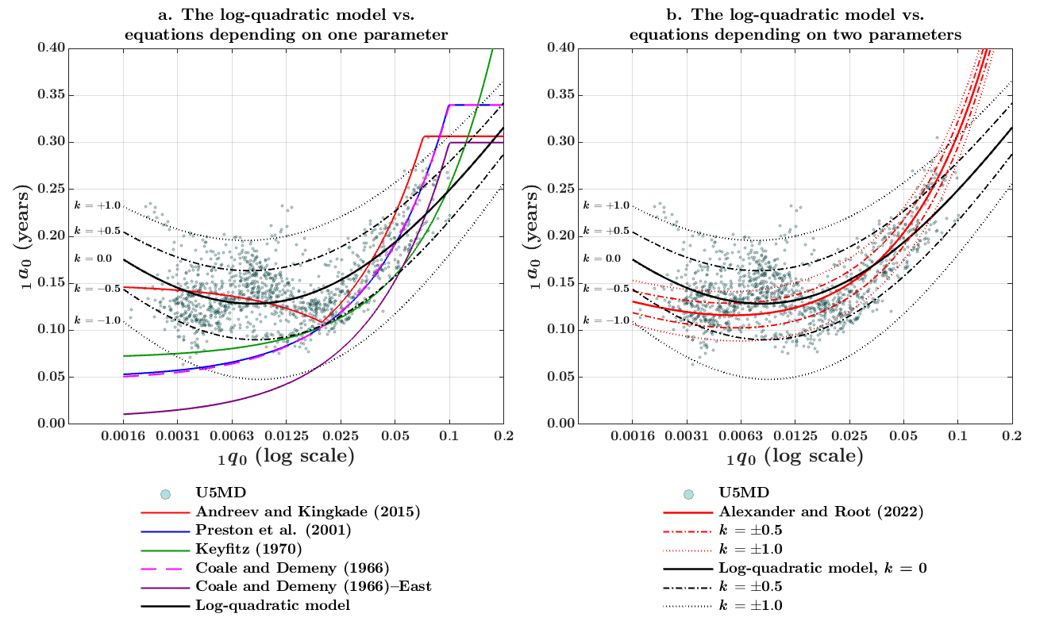
1. Athens in 1981, female population
https://doi.org/10.1215/00703370-11330227

Slide 6

1. Athens in 1981, female population
x | _{n}m_{x} | n | _{n}a_{x} | _{n}q_{x} | _{n}p_{x} | l_{x} | _{n}d_{x} | _{n}L_{x} | T_{x} | e_{x}
0 |  | 1 | 0.3 |  |  | 100,000 | 1,821
1 |  | 4 | 0.4 |  |  | 98,179
5 |  | 5 | 0.5 |  |  | 97,884
10 |  | 5 | 0.5 |  |  | 97,752 |  |  |  | 66.385
15 |  | 5 | 0.5 |  |  | 97,658
20 |  | 5 | 0.5 |  |  | 97,512
25 |  | 5 | 0.5 |  |  | 97,313
30 |  | 5 | 0.5 |  |  | 97,068
35 |  | 5 | 0.5 |  |  | 96,761
40 |  | 5 | 0.5 |  |  | 96,343
45 |  | 5 | 0.5 |  |  | 95,721
50 |  | 5 | 0.5 |  |  | 94,669
55 |  | 5 | 0.5 |  |  | 92,945
60 |  | 5 | 0.5 |  |  | 90,131
65 |  | 5 | 0.5 |  |  | 85,492
70 |  | 5 | 0.5 |  |  | 77,598
75 |  | 5 | 0.5 |  |  | 65,075
80 |  | 5 | 0.5 |  |  | 47,402
85+ |  |  |  |  |  | 27,701
3. Calculate $\text{n}\text{d}\text{x}$, decumulating l_{x}.
$$\text{n}\text{d}\text{x}=\text{l}\text{x}−\text{l}\text{x}\text{+}\text{n}$$

Slide 7
1. Athens in 1981, female population
x | _{n}m_{x} | n | _{n}a_{x} | _{n}q_{x} | _{n}p_{x} | l_{x} | _{n}d_{x} | _{n}L_{x} | T_{x} | e_{x}
0 |  | 1 | 0.3 |  |  | 100,000 | 1,821
1 |  | 4 | 0.4 |  |  | 98,179 | 295
5 |  | 5 | 0.5 |  |  | 97,884
10 |  | 5 | 0.5 |  |  | 97,752 |  |  |  | 66.385
15 |  | 5 | 0.5 |  |  | 97,658
20 |  | 5 | 0.5 |  |  | 97,512
25 |  | 5 | 0.5 |  |  | 97,313
30 |  | 5 | 0.5 |  |  | 97,068
35 |  | 5 | 0.5 |  |  | 96,761
40 |  | 5 | 0.5 |  |  | 96,343
45 |  | 5 | 0.5 |  |  | 95,721
50 |  | 5 | 0.5 |  |  | 94,669
55 |  | 5 | 0.5 |  |  | 92,945
60 |  | 5 | 0.5 |  |  | 90,131
65 |  | 5 | 0.5 |  |  | 85,492
70 |  | 5 | 0.5 |  |  | 77,598
75 |  | 5 | 0.5 |  |  | 65,075
80 |  | 5 | 0.5 |  |  | 47,402
85+ |  |  |  |  |  | 27,701
3. Calculate $\text{n}\text{d}\text{x}$, decumulating l_{x}.
$$\text{n}\text{d}\text{x}=\text{l}\text{x}−\text{l}\text{x}\text{+}\text{n}$$

Slide 8

1. Athens in 1981, female population
x | _{n}m_{x} | n | _{n}a_{x} | _{n}q_{x} | _{n}p_{x} | l_{x} | _{n}d_{x} | _{n}L_{x} | T_{x} | e_{x}
0 |  | 1 | 0.3 |  |  | 100,000 | 1,821
1 |  | 4 | 0.4 |  |  | 98,179 | 295
5 |  | 5 | 0.5 |  |  | 97,884 | 132
10 |  | 5 | 0.5 |  |  | 97,752 | 94 |  |  | 66.385
15 |  | 5 | 0.5 |  |  | 97,658 | 146
20 |  | 5 | 0.5 |  |  | 97,512 | 199
25 |  | 5 | 0.5 |  |  | 97,313 | 245
30 |  | 5 | 0.5 |  |  | 97,068 | 307
35 |  | 5 | 0.5 |  |  | 96,761 | 418
40 |  | 5 | 0.5 |  |  | 96,343 | 622
45 |  | 5 | 0.5 |  |  | 95,721 | 1,052
50 |  | 5 | 0.5 |  |  | 94,669 | 1,724
55 |  | 5 | 0.5 |  |  | 92,945 | 2,814
60 |  | 5 | 0.5 |  |  | 90,131 | 4,639
65 |  | 5 | 0.5 |  |  | 85,492 | 7,894
70 |  | 5 | 0.5 |  |  | 77,598 | 12,523
75 |  | 5 | 0.5 |  |  | 65,075 | 17,673
80 |  | 5 | 0.5 |  |  | 47,402 | 19,701
85+ |  |  |  |  |  | 27,701 | 27,701
3. Calculate $\text{n}\text{d}\text{x}$, decumulating l_{x}.
$$\text{n}\text{d}\text{x}=\text{l}\text{x}−\text{l}\text{x}\text{+}\text{n}$$
and
$$∞\text{d}\text{85}=\text{l}\text{85}$$

Slide 9

1. Athens in 1981, female population
x | _{n}m_{x} | n | _{n}a_{x} | _{n}q_{x} | _{n}p_{x} | l_{x} | _{n}d_{x} | _{n}L_{x} | T_{x} | e_{x}
0 |  | 1 | 0.3 | 0.0182 |  | 100,000 | 1,821
1 |  | 4 | 0.4 | 0.0030 |  | 98,179 | 295
5 |  | 5 | 0.5 | 0.0013 |  | 97,884 | 132
10 |  | 5 | 0.5 | 0.0010 |  | 97,752 | 94 |  |  | 66.385
15 |  | 5 | 0.5 | 0.0015 |  | 97,658 | 146
20 |  | 5 | 0.5 | 0.0020 |  | 97,512 | 199
25 |  | 5 | 0.5 | 0.0025 |  | 97,313 | 245
30 |  | 5 | 0.5 | 0.0032 |  | 97,068 | 307
35 |  | 5 | 0.5 | 0.0043 |  | 96,761 | 418
40 |  | 5 | 0.5 | 0.0065 |  | 96,343 | 622
45 |  | 5 | 0.5 | 0.0110 |  | 95,721 | 1,052
50 |  | 5 | 0.5 | 0.0182 |  | 94,669 | 1,724
55 |  | 5 | 0.5 | 0.0303 |  | 92,945 | 2,814
60 |  | 5 | 0.5 | 0.0515 |  | 90,131 | 4,639
65 |  | 5 | 0.5 | 0.0923 |  | 85,492 | 7,894
70 |  | 5 | 0.5 | 0.1614 |  | 77,598 | 12,523
75 |  | 5 | 0.5 | 0.2716 |  | 65,075 | 17,673
80 |  | 5 | 0.5 | 0.4156 |  | 47,402 | 19,701
85+ |  |  |  | 1.0000 |  | 27,701 | 27,701
4. Calculate $\text{n}\text{q}\text{x}$, dividing $\text{n}\text{d}\text{x}$ by l_{x}.
$$\text{n}\text{q}\text{x}=\frac{\text{n}\text{d}\text{x}}{\text{l}\text{x}}$$

Slide 10

1. Athens in 1981, female population
x | _{n}m_{x} | n | _{n}a_{x} | _{n}q_{x} | _{n}p_{x} | l_{x} | _{n}d_{x} | _{n}L_{x} | T_{x} | e_{x}
0 |  | 1 | 0.3 | 0.0182 | 0.9818 | 100,000 | 1,821
1 |  | 4 | 0.4 | 0.0030 | 0.9970 | 98,179 | 295
5 |  | 5 | 0.5 | 0.0013 | 0.9987 | 97,884 | 132
10 |  | 5 | 0.5 | 0.0010 | 0.9990 | 97,752 | 94 |  |  | 66.385
15 |  | 5 | 0.5 | 0.0015 | 0.9985 | 97,658 | 146
20 |  | 5 | 0.5 | 0.0020 | 0.9980 | 97,512 | 199
25 |  | 5 | 0.5 | 0.0025 | 0.9975 | 97,313 | 245
30 |  | 5 | 0.5 | 0.0032 | 0.9968 | 97,068 | 307
35 |  | 5 | 0.5 | 0.0043 | 0.9957 | 96,761 | 418
40 |  | 5 | 0.5 | 0.0065 | 0.9935 | 96,343 | 622
45 |  | 5 | 0.5 | 0.0110 | 0.9890 | 95,721 | 1,052
50 |  | 5 | 0.5 | 0.0182 | 0.9818 | 94,669 | 1,724
55 |  | 5 | 0.5 | 0.0303 | 0.9697 | 92,945 | 2,814
60 |  | 5 | 0.5 | 0.0515 | 0.9485 | 90,131 | 4,639
65 |  | 5 | 0.5 | 0.0923 | 0.9077 | 85,492 | 7,894
70 |  | 5 | 0.5 | 0.1614 | 0.8386 | 77,598 | 12,523
75 |  | 5 | 0.5 | 0.2716 | 0.7284 | 65,075 | 17,673
80 |  | 5 | 0.5 | 0.4156 | 0.5844 | 47,402 | 19,701
85+ |  |  |  | 1.0000 | 0.0000 | 27,701 | 27,701
5. Calculate _{n}p_{x} as a function of _{n}q_{x}.
$$\text{n}\text{p}\text{x}=\text{1}−\text{n}\text{q}\text{x}$$

Slide 11

1. Athens in 1981, female population
x | _{n}m_{x} | n | _{n}a_{x} | _{n}q_{x} | _{n}p_{x} | l_{x} | _{n}d_{x} | _{n}L_{x} | T_{x} | e_{x}
0 |  | 1 | 0.3 | 0.0182 | 0.9818 | 100,000 | 1,821 | 98,725
1 |  | 4 | 0.4 | 0.0030 | 0.9970 | 98,179 | 295 | 392,008
5 |  | 5 | 0.5 | 0.0013 | 0.9987 | 97,884 | 132 | 489,090
10 |  | 5 | 0.5 | 0.0010 | 0.9990 | 97,752 | 94 | 488,525 |  | 66.385
15 |  | 5 | 0.5 | 0.0015 | 0.9985 | 97,658 | 146 | 487,925
20 |  | 5 | 0.5 | 0.0020 | 0.9980 | 97,512 | 199 | 487,063
25 |  | 5 | 0.5 | 0.0025 | 0.9975 | 97,313 | 245 | 485,953
30 |  | 5 | 0.5 | 0.0032 | 0.9968 | 97,068 | 307 | 484,573
35 |  | 5 | 0.5 | 0.0043 | 0.9957 | 96,761 | 418 | 482,760
40 |  | 5 | 0.5 | 0.0065 | 0.9935 | 96,343 | 622 | 480,160
45 |  | 5 | 0.5 | 0.0110 | 0.9890 | 95,721 | 1,052 | 475,975
50 |  | 5 | 0.5 | 0.0182 | 0.9818 | 94,669 | 1,724 | 469,035
55 |  | 5 | 0.5 | 0.0303 | 0.9697 | 92,945 | 2,814 | 457,690
60 |  | 5 | 0.5 | 0.0515 | 0.9485 | 90,131 | 4,639 | 439,058
65 |  | 5 | 0.5 | 0.0923 | 0.9077 | 85,492 | 7,894 | 407,725
70 |  | 5 | 0.5 | 0.1614 | 0.8386 | 77,598 | 12,523 | 356,683
75 |  | 5 | 0.5 | 0.2716 | 0.7284 | 65,075 | 17,673 | 281,193
80 |  | 5 | 0.5 | 0.4156 | 0.5844 | 47,402 | 19,701 | 187,758
85+ |  |  |  | 1.0000 | 0.0000 | 27,701 | 27,701
6. Use a formula to calculate $\text{n}\text{L}\text{x}$.
$$\text{n}\text{L}\text{x}=\text{n}∙\left(\text{l}\text{x}−\text{n}\text{d}\text{x}\right)\text{+}\text{n}∙\text{n}\text{a}\text{x}∙\text{n}\text{d}\text{x}$$
$\text{n}\text{L}\text{x}$ is the number of person-years lived in the age interval. While each survivor contributes with n years (in blue), each deceased contributes n times $\text{n}\text{a}\text{x}$ years (in red).

Slide 12

1. Athens in 1981, female population
x | _{n}m_{x} | n | _{n}a_{x} | _{n}q_{x} | _{n}p_{x} | l_{x} | _{n}d_{x} | _{n}L_{x} | T_{x} | e_{x}
0 |  | 1 | 0.3 | 0.0182 | 0.9818 | 100,000 | 1,821 | 98,725
1 |  | 4 | 0.4 | 0.0030 | 0.9970 | 98,179 | 295 | 392,008
5 |  | 5 | 0.5 | 0.0013 | 0.9987 | 97,884 | 132 | 489,090
10 |  | 5 | 0.5 | 0.0010 | 0.9990 | 97,752 | 94 | 488,525 | 6,489,267 | 66.385
15 |  | 5 | 0.5 | 0.0015 | 0.9985 | 97,658 | 146 | 487,925
20 |  | 5 | 0.5 | 0.0020 | 0.9980 | 97,512 | 199 | 487,063
25 |  | 5 | 0.5 | 0.0025 | 0.9975 | 97,313 | 245 | 485,953
30 |  | 5 | 0.5 | 0.0032 | 0.9968 | 97,068 | 307 | 484,573
35 |  | 5 | 0.5 | 0.0043 | 0.9957 | 96,761 | 418 | 482,760
40 |  | 5 | 0.5 | 0.0065 | 0.9935 | 96,343 | 622 | 480,160
45 |  | 5 | 0.5 | 0.0110 | 0.9890 | 95,721 | 1,052 | 475,975
50 |  | 5 | 0.5 | 0.0182 | 0.9818 | 94,669 | 1,724 | 469,035
55 |  | 5 | 0.5 | 0.0303 | 0.9697 | 92,945 | 2,814 | 457,690
60 |  | 5 | 0.5 | 0.0515 | 0.9485 | 90,131 | 4,639 | 439,058
65 |  | 5 | 0.5 | 0.0923 | 0.9077 | 85,492 | 7,894 | 407,725
70 |  | 5 | 0.5 | 0.1614 | 0.8386 | 77,598 | 12,523 | 356,683
75 |  | 5 | 0.5 | 0.2716 | 0.7284 | 65,075 | 17,673 | 281,193
80 |  | 5 | 0.5 | 0.4156 | 0.5844 | 47,402 | 19,701 | 187,758
85+ |  |  |  | 1.0000 | 0.0000 | 27,701 | 27,701
7. Calculate T₁₀ from e₁₀
and l₁₀
$$\text{T}\text{10}=\text{l}\text{10}∙\text{e}\text{10}$$

Slide 13

1. Athens in 1981, female population
x | _{n}m_{x} | n | _{n}a_{x} | _{n}q_{x} | _{n}p_{x} | l_{x} | _{n}d_{x} | _{n}L_{x} | T_{x} | e_{x}
0 |  | 1 | 0.3 | 0.0182 | 0.9818 | 100,000 | 1,821 | 98,725
1 |  | 4 | 0.4 | 0.0030 | 0.9970 | 98,179 | 295 | 392,008
5 |  | 5 | 0.5 | 0.0013 | 0.9987 | 97,884 | 132 | 489,090
10 |  | 5 | 0.5 | 0.0010 | 0.9990 | 97,752 | 94 | 488,525 | 6,489,267 | 66.385
15 |  | 5 | 0.5 | 0.0015 | 0.9985 | 97,658 | 146 | 487,925
20 |  | 5 | 0.5 | 0.0020 | 0.9980 | 97,512 | 199 | 487,063
25 |  | 5 | 0.5 | 0.0025 | 0.9975 | 97,313 | 245 | 485,953
30 |  | 5 | 0.5 | 0.0032 | 0.9968 | 97,068 | 307 | 484,573
35 |  | 5 | 0.5 | 0.0043 | 0.9957 | 96,761 | 418 | 482,760
40 |  | 5 | 0.5 | 0.0065 | 0.9935 | 96,343 | 622 | 480,160
45 |  | 5 | 0.5 | 0.0110 | 0.9890 | 95,721 | 1,052 | 475,975
50 |  | 5 | 0.5 | 0.0182 | 0.9818 | 94,669 | 1,724 | 469,035
55 |  | 5 | 0.5 | 0.0303 | 0.9697 | 92,945 | 2,814 | 457,690
60 |  | 5 | 0.5 | 0.0515 | 0.9485 | 90,131 | 4,639 | 439,058
65 |  | 5 | 0.5 | 0.0923 | 0.9077 | 85,492 | 7,894 | 407,725
70 |  | 5 | 0.5 | 0.1614 | 0.8386 | 77,598 | 12,523 | 356,683
75 |  | 5 | 0.5 | 0.2716 | 0.7284 | 65,075 | 17,673 | 281,193
80 |  | 5 | 0.5 | 0.4156 | 0.5844 | 47,402 | 19,701 | 187,758
85+ |  |  |  | 1.0000 | 0.0000 | 27,701 | 27,701 | 17,194
8. Calculate $∞\text{L}\text{85}$ (i.e., open-ended age interval) as the difference between T₁₀ and $\text{70}\text{L}\text{10}$
$$∞\text{L}\text{85}=\text{T}\text{10}\text{−}\text{70}\text{L}\text{10}$$

Slide 14

1. Athens in 1981, female population
x | _{n}m_{x} | n | _{n}a_{x} | _{n}q_{x} | _{n}p_{x} | l_{x} | _{n}d_{x} | _{n}L_{x} | T_{x} | e_{x}
0 |  | 1 | 0.3 | 0.0182 | 0.9818 | 100,000 | 1,821 | 98,725
1 |  | 4 | 0.4 | 0.0030 | 0.9970 | 98,179 | 295 | 392,008
5 |  | 5 | 0.5 | 0.0013 | 0.9987 | 97,884 | 132 | 489,090
10 |  | 5 | 0.5 | 0.0010 | 0.9990 | 97,752 | 94 | 488,525 | 6,489,267 | 66.385
15 |  | 5 | 0.5 | 0.0015 | 0.9985 | 97,658 | 146 | 487,925 | 6,000,742
20 |  | 5 | 0.5 | 0.0020 | 0.9980 | 97,512 | 199 | 487,063
25 |  | 5 | 0.5 | 0.0025 | 0.9975 | 97,313 | 245 | 485,953
30 |  | 5 | 0.5 | 0.0032 | 0.9968 | 97,068 | 307 | 484,573
35 |  | 5 | 0.5 | 0.0043 | 0.9957 | 96,761 | 418 | 482,760
40 |  | 5 | 0.5 | 0.0065 | 0.9935 | 96,343 | 622 | 480,160
45 |  | 5 | 0.5 | 0.0110 | 0.9890 | 95,721 | 1,052 | 475,975
50 |  | 5 | 0.5 | 0.0182 | 0.9818 | 94,669 | 1,724 | 469,035
55 |  | 5 | 0.5 | 0.0303 | 0.9697 | 92,945 | 2,814 | 457,690
60 |  | 5 | 0.5 | 0.0515 | 0.9485 | 90,131 | 4,639 | 439,058
65 |  | 5 | 0.5 | 0.0923 | 0.9077 | 85,492 | 7,894 | 407,725
70 |  | 5 | 0.5 | 0.1614 | 0.8386 | 77,598 | 12,523 | 356,683
75 |  | 5 | 0.5 | 0.2716 | 0.7284 | 65,075 | 17,673 | 281,193
80 |  | 5 | 0.5 | 0.4156 | 0.5844 | 47,402 | 19,701 | 187,758
85+ |  |  |  | 1.0000 | 0.0000 | 27,701 | 27,701 | 17,194
9. Calculate $\text{T}\text{x}$ as the cumulative sum of $\text{n}\text{L}\text{x}$ from x to infinity.

Slide 15
1. Athens in 1981, female population
x | _{n}m_{x} | n | _{n}a_{x} | _{n}q_{x} | _{n}p_{x} | l_{x} | _{n}d_{x} | _{n}L_{x} | T_{x} | e_{x}
0 |  | 1 | 0.3 | 0.0182 | 0.9818 | 100,000 | 1,821 | 98,725
1 |  | 4 | 0.4 | 0.0030 | 0.9970 | 98,179 | 295 | 392,008
5 |  | 5 | 0.5 | 0.0013 | 0.9987 | 97,884 | 132 | 489,090
10 |  | 5 | 0.5 | 0.0010 | 0.9990 | 97,752 | 94 | 488,525 | 6,489,267 | 66.385
15 |  | 5 | 0.5 | 0.0015 | 0.9985 | 97,658 | 146 | 487,925 | 6,000,742
20 |  | 5 | 0.5 | 0.0020 | 0.9980 | 97,512 | 199 | 487,063 | 5,512,817
25 |  | 5 | 0.5 | 0.0025 | 0.9975 | 97,313 | 245 | 485,953
30 |  | 5 | 0.5 | 0.0032 | 0.9968 | 97,068 | 307 | 484,573
35 |  | 5 | 0.5 | 0.0043 | 0.9957 | 96,761 | 418 | 482,760
40 |  | 5 | 0.5 | 0.0065 | 0.9935 | 96,343 | 622 | 480,160
45 |  | 5 | 0.5 | 0.0110 | 0.9890 | 95,721 | 1,052 | 475,975
50 |  | 5 | 0.5 | 0.0182 | 0.9818 | 94,669 | 1,724 | 469,035
55 |  | 5 | 0.5 | 0.0303 | 0.9697 | 92,945 | 2,814 | 457,690
60 |  | 5 | 0.5 | 0.0515 | 0.9485 | 90,131 | 4,639 | 439,058
65 |  | 5 | 0.5 | 0.0923 | 0.9077 | 85,492 | 7,894 | 407,725
70 |  | 5 | 0.5 | 0.1614 | 0.8386 | 77,598 | 12,523 | 356,683
75 |  | 5 | 0.5 | 0.2716 | 0.7284 | 65,075 | 17,673 | 281,193
80 |  | 5 | 0.5 | 0.4156 | 0.5844 | 47,402 | 19,701 | 187,758
85+ |  |  |  | 1.0000 | 0.0000 | 27,701 | 27,701 | 17,194
9. Calculate $\text{T}\text{x}$ as the cumulative sum of $\text{n}\text{L}\text{x}$ from x to infinity.

Slide 16

1. Athens in 1981, female population
x | _{n}m_{x} | n | _{n}a_{x} | _{n}q_{x} | _{n}p_{x} | l_{x} | _{n}d_{x} | _{n}L_{x} | T_{x} | e_{x}
0 |  | 1 | 0.3 | 0.0182 | 0.9818 | 100,000 | 1,821 | 98,725
1 |  | 4 | 0.4 | 0.0030 | 0.9970 | 98,179 | 295 | 392,008
5 |  | 5 | 0.5 | 0.0013 | 0.9987 | 97,884 | 132 | 489,090
10 |  | 5 | 0.5 | 0.0010 | 0.9990 | 97,752 | 94 | 488,525 | 6,489,267 | 66.385
15 |  | 5 | 0.5 | 0.0015 | 0.9985 | 97,658 | 146 | 487,925 | 6,000,742
20 |  | 5 | 0.5 | 0.0020 | 0.9980 | 97,512 | 199 | 487,063 | 5,512,817
25 |  | 5 | 0.5 | 0.0025 | 0.9975 | 97,313 | 245 | 485,953 | 5,025,754
30 |  | 5 | 0.5 | 0.0032 | 0.9968 | 97,068 | 307 | 484,573 | 4,539,802
35 |  | 5 | 0.5 | 0.0043 | 0.9957 | 96,761 | 418 | 482,760 | 4,055,229
40 |  | 5 | 0.5 | 0.0065 | 0.9935 | 96,343 | 622 | 480,160 | 3,572,469
45 |  | 5 | 0.5 | 0.0110 | 0.9890 | 95,721 | 1,052 | 475,975 | 3,092,309
50 |  | 5 | 0.5 | 0.0182 | 0.9818 | 94,669 | 1,724 | 469,035 | 2,616,334
55 |  | 5 | 0.5 | 0.0303 | 0.9697 | 92,945 | 2,814 | 457,690 | 2,147,299
60 |  | 5 | 0.5 | 0.0515 | 0.9485 | 90,131 | 4,639 | 439,058 | 1,689,609
65 |  | 5 | 0.5 | 0.0923 | 0.9077 | 85,492 | 7,894 | 407,725 | 1,250,552
70 |  | 5 | 0.5 | 0.1614 | 0.8386 | 77,598 | 12,523 | 356,683 | 842,827
75 |  | 5 | 0.5 | 0.2716 | 0.7284 | 65,075 | 17,673 | 281,193 | 486,144
80 |  | 5 | 0.5 | 0.4156 | 0.5844 | 47,402 | 19,701 | 187,758 | 204,952
85+ |  |  |  | 1.0000 | 0.0000 | 27,701 | 27,701 | 17,194 | 17,194
9. Calculate $\text{T}\text{x}$ as the cumulative sum of $\text{n}\text{L}\text{x}$ from x to infinity.
By construction, $\text{T}\text{x}$ and $\text{n}\text{L}\text{x}$ should have the same value at the open-ended age interval.

Slide 17
1. Athens in 1981, female population
x | _{n}m_{x} | n | _{n}a_{x} | _{n}q_{x} | _{n}p_{x} | l_{x} | _{n}d_{x} | _{n}L_{x} | T_{x} | e_{x}
0 |  | 1 | 0.3 | 0.0182 | 0.9818 | 100,000 | 1,821 | 98,725 | 7,469,090
1 |  | 4 | 0.4 | 0.0030 | 0.9970 | 98,179 | 295 | 392,008
5 |  | 5 | 0.5 | 0.0013 | 0.9987 | 97,884 | 132 | 489,090
10 |  | 5 | 0.5 | 0.0010 | 0.9990 | 97,752 | 94 | 488,525 | 6,489,267 | 66.385
15 |  | 5 | 0.5 | 0.0015 | 0.9985 | 97,658 | 146 | 487,925 | 6,000,742
20 |  | 5 | 0.5 | 0.0020 | 0.9980 | 97,512 | 199 | 487,063 | 5,512,817
25 |  | 5 | 0.5 | 0.0025 | 0.9975 | 97,313 | 245 | 485,953 | 5,025,754
30 |  | 5 | 0.5 | 0.0032 | 0.9968 | 97,068 | 307 | 484,573 | 4,539,802
35 |  | 5 | 0.5 | 0.0043 | 0.9957 | 96,761 | 418 | 482,760 | 4,055,229
40 |  | 5 | 0.5 | 0.0065 | 0.9935 | 96,343 | 622 | 480,160 | 3,572,469
45 |  | 5 | 0.5 | 0.0110 | 0.9890 | 95,721 | 1,052 | 475,975 | 3,092,309
50 |  | 5 | 0.5 | 0.0182 | 0.9818 | 94,669 | 1,724 | 469,035 | 2,616,334
55 |  | 5 | 0.5 | 0.0303 | 0.9697 | 92,945 | 2,814 | 457,690 | 2,147,299
60 |  | 5 | 0.5 | 0.0515 | 0.9485 | 90,131 | 4,639 | 439,058 | 1,689,609
65 |  | 5 | 0.5 | 0.0923 | 0.9077 | 85,492 | 7,894 | 407,725 | 1,250,552
70 |  | 5 | 0.5 | 0.1614 | 0.8386 | 77,598 | 12,523 | 356,683 | 842,827
75 |  | 5 | 0.5 | 0.2716 | 0.7284 | 65,075 | 17,673 | 281,193 | 486,144
80 |  | 5 | 0.5 | 0.4156 | 0.5844 | 47,402 | 19,701 | 187,758 | 204,952
85+ |  |  |  | 1.0000 | 0.0000 | 27,701 | 27,701 | 17,194 | 17,194
9. Calculate $\text{T}\text{x}$ as the cumulative sum of $\text{n}\text{L}\text{x}$ from x to infinity.

Slide 18
1. Athens in 1981, female population
x | _{n}m_{x} | n | _{n}a_{x} | _{n}q_{x} | _{n}p_{x} | l_{x} | _{n}d_{x} | _{n}L_{x} | T_{x} | e_{x}
0 |  | 1 | 0.3 | 0.0182 | 0.9818 | 100,000 | 1,821 | 98,725 | 7,469,090
1 |  | 4 | 0.4 | 0.0030 | 0.9970 | 98,179 | 295 | 392,008 | 7,370,365
5 |  | 5 | 0.5 | 0.0013 | 0.9987 | 97,884 | 132 | 489,090 | 6,978,357
10 |  | 5 | 0.5 | 0.0010 | 0.9990 | 97,752 | 94 | 488,525 | 6,489,267 | 66.385
15 |  | 5 | 0.5 | 0.0015 | 0.9985 | 97,658 | 146 | 487,925 | 6,000,742
20 |  | 5 | 0.5 | 0.0020 | 0.9980 | 97,512 | 199 | 487,063 | 5,512,817
25 |  | 5 | 0.5 | 0.0025 | 0.9975 | 97,313 | 245 | 485,953 | 5,025,754
30 |  | 5 | 0.5 | 0.0032 | 0.9968 | 97,068 | 307 | 484,573 | 4,539,802
35 |  | 5 | 0.5 | 0.0043 | 0.9957 | 96,761 | 418 | 482,760 | 4,055,229
40 |  | 5 | 0.5 | 0.0065 | 0.9935 | 96,343 | 622 | 480,160 | 3,572,469
45 |  | 5 | 0.5 | 0.0110 | 0.9890 | 95,721 | 1,052 | 475,975 | 3,092,309
50 |  | 5 | 0.5 | 0.0182 | 0.9818 | 94,669 | 1,724 | 469,035 | 2,616,334
55 |  | 5 | 0.5 | 0.0303 | 0.9697 | 92,945 | 2,814 | 457,690 | 2,147,299
60 |  | 5 | 0.5 | 0.0515 | 0.9485 | 90,131 | 4,639 | 439,058 | 1,689,609
65 |  | 5 | 0.5 | 0.0923 | 0.9077 | 85,492 | 7,894 | 407,725 | 1,250,552
70 |  | 5 | 0.5 | 0.1614 | 0.8386 | 77,598 | 12,523 | 356,683 | 842,827
75 |  | 5 | 0.5 | 0.2716 | 0.7284 | 65,075 | 17,673 | 281,193 | 486,144
80 |  | 5 | 0.5 | 0.4156 | 0.5844 | 47,402 | 19,701 | 187,758 | 204,952
85+ |  |  |  | 1.0000 | 0.0000 | 27,701 | 27,701 | 17,194 | 17,194
9. Calculate $\text{T}\text{x}$ as the cumulative sum of $\text{n}\text{L}\text{x}$ from x to infinity.

Slide 19

1. Athens in 1981, female population
x | _{n}m_{x} | n | _{n}a_{x} | _{n}q_{x} | _{n}p_{x} | l_{x} | _{n}d_{x} | _{n}L_{x} | T_{x} | e_{x}
0 |  | 1 | 0.3 | 0.0182 | 0.9818 | 100,000 | 1,821 | 98,725 | 7,469,090 | 74.691
1 |  | 4 | 0.4 | 0.0030 | 0.9970 | 98,179 | 295 | 392,008 | 7,370,365 | 75.071
5 |  | 5 | 0.5 | 0.0013 | 0.9987 | 97,884 | 132 | 489,090 | 6,978,357 | 71.292
10 |  | 5 | 0.5 | 0.0010 | 0.9990 | 97,752 | 94 | 488,525 | 6,489,267 | 66.385
15 |  | 5 | 0.5 | 0.0015 | 0.9985 | 97,658 | 146 | 487,925 | 6,000,742 | 61.446
20 |  | 5 | 0.5 | 0.0020 | 0.9980 | 97,512 | 199 | 487,063 | 5,512,817 | 56.535
25 |  | 5 | 0.5 | 0.0025 | 0.9975 | 97,313 | 245 | 485,953 | 5,025,754 | 51.645
30 |  | 5 | 0.5 | 0.0032 | 0.9968 | 97,068 | 307 | 484,573 | 4,539,802 | 46.769
35 |  | 5 | 0.5 | 0.0043 | 0.9957 | 96,761 | 418 | 482,760 | 4,055,229 | 41.910
40 |  | 5 | 0.5 | 0.0065 | 0.9935 | 96,343 | 622 | 480,160 | 3,572,469 | 37.081
45 |  | 5 | 0.5 | 0.0110 | 0.9890 | 95,721 | 1,052 | 475,975 | 3,092,309 | 32.305
50 |  | 5 | 0.5 | 0.0182 | 0.9818 | 94,669 | 1,724 | 469,035 | 2,616,334 | 27.637
55 |  | 5 | 0.5 | 0.0303 | 0.9697 | 92,945 | 2,814 | 457,690 | 2,147,299 | 23.103
60 |  | 5 | 0.5 | 0.0515 | 0.9485 | 90,131 | 4,639 | 439,058 | 1,689,609 | 18.746
65 |  | 5 | 0.5 | 0.0923 | 0.9077 | 85,492 | 7,894 | 407,725 | 1,250,552 | 14.628
70 |  | 5 | 0.5 | 0.1614 | 0.8386 | 77,598 | 12,523 | 356,683 | 842,827 | 10.861
75 |  | 5 | 0.5 | 0.2716 | 0.7284 | 65,075 | 17,673 | 281,193 | 486,144 | 7.471
80 |  | 5 | 0.5 | 0.4156 | 0.5844 | 47,402 | 19,701 | 187,758 | 204,952 | 4.324
85+ |  |  |  | 1.0000 | 0.0000 | 27,701 | 27,701 | 17,194 | 17,194 | 0.621
10. Calculate $\text{e}\text{x}$ as a function of $\text{T}\text{x}$ and $\text{l}\text{x}$.
$$\text{e}\text{x}=\frac{\text{T}\text{x}}{\text{l}\text{x}}$$

Slide 20

1. Athens in 1981, female population
x | _{n}m_{x} | n | _{n}a_{x} | _{n}q_{x} | _{n}p_{x} | l_{x} | _{n}d_{x} | _{n}L_{x} | T_{x} | e_{x}
0 | 0.0184 | 1 | 0.3 | 0.0182 | 0.9818 | 100,000 | 1,821 | 98,725 | 7,469,090 | 74.691
1 | 0.0008 | 4 | 0.4 | 0.0030 | 0.9970 | 98,179 | 295 | 392,008 | 7,370,365 | 75.071
5 | 0.0003 | 5 | 0.5 | 0.0013 | 0.9987 | 97,884 | 132 | 489,090 | 6,978,357 | 71.292
10 | 0.0002 | 5 | 0.5 | 0.0010 | 0.9990 | 97,752 | 94 | 488,525 | 6,489,267 | 66.385
15 | 0.0003 | 5 | 0.5 | 0.0015 | 0.9985 | 97,658 | 146 | 487,925 | 6,000,742 | 61.446
20 | 0.0004 | 5 | 0.5 | 0.0020 | 0.9980 | 97,512 | 199 | 487,063 | 5,512,817 | 56.535
25 | 0.0005 | 5 | 0.5 | 0.0025 | 0.9975 | 97,313 | 245 | 485,953 | 5,025,754 | 51.645
30 | 0.0006 | 5 | 0.5 | 0.0032 | 0.9968 | 97,068 | 307 | 484,573 | 4,539,802 | 46.769
35 | 0.0009 | 5 | 0.5 | 0.0043 | 0.9957 | 96,761 | 418 | 482,760 | 4,055,229 | 41.910
40 | 0.0013 | 5 | 0.5 | 0.0065 | 0.9935 | 96,343 | 622 | 480,160 | 3,572,469 | 37.081
45 | 0.0022 | 5 | 0.5 | 0.0110 | 0.9890 | 95,721 | 1,052 | 475,975 | 3,092,309 | 32.305
50 | 0.0037 | 5 | 0.5 | 0.0182 | 0.9818 | 94,669 | 1,724 | 469,035 | 2,616,334 | 27.637
55 | 0.0061 | 5 | 0.5 | 0.0303 | 0.9697 | 92,945 | 2,814 | 457,690 | 2,147,299 | 23.103
60 | 0.0106 | 5 | 0.5 | 0.0515 | 0.9485 | 90,131 | 4,639 | 439,058 | 1,689,609 | 18.746
65 | 0.0194 | 5 | 0.5 | 0.0923 | 0.9077 | 85,492 | 7,894 | 407,725 | 1,250,552 | 14.628
70 | 0.0351 | 5 | 0.5 | 0.1614 | 0.8386 | 77,598 | 12,523 | 356,683 | 842,827 | 10.861
75 | 0.0629 | 5 | 0.5 | 0.2716 | 0.7284 | 65,075 | 17,673 | 281,193 | 486,144 | 7.471
80 | 0.1049 | 5 | 0.5 | 0.4156 | 0.5844 | 47,402 | 19,701 | 187,758 | 204,952 | 4.324
85+ | 1.6111 |  |  | 1.0000 | 0.0000 | 27,701 | 27,701 | 17,194 | 17,194 | 0.621
11. Use an identity to calculate $\text{n}\text{m}\text{x}$ at all ages.
$$\text{n}\text{m}\text{x}=\frac{\text{n}\text{d}\text{x}}{\text{n}\text{L}\text{x}}$$

Slide 21
1. Athens in 1981, female population
x | _{n}m_{x} | n | _{n}a_{x} | _{n}q_{x} | _{n}p_{x} | l_{x} | _{n}d_{x} | _{n}L_{x} | T_{x} | e_{x}
0 | 0.0184 | 1 | 0.3 | 0.0182 | 0.9818 | 100,000 | 1,821 | 98,725 | 7,469,090 | 74.691
1 | 0.0008 | 4 | 0.4 | 0.0030 | 0.9970 | 98,179 | 295 | 392,008 | 7,370,365 | 75.071
5 | 0.0003 | 5 | 0.5 | 0.0013 | 0.9987 | 97,884 | 132 | 489,090 | 6,978,357 | 71.292
10 | 0.0002 | 5 | 0.5 | 0.0010 | 0.9990 | 97,752 | 94 | 488,525 | 6,489,267 | 66.385
15 | 0.0003 | 5 | 0.5 | 0.0015 | 0.9985 | 97,658 | 146 | 487,925 | 6,000,742 | 61.446
20 | 0.0004 | 5 | 0.5 | 0.0020 | 0.9980 | 97,512 | 199 | 487,063 | 5,512,817 | 56.535
25 | 0.0005 | 5 | 0.5 | 0.0025 | 0.9975 | 97,313 | 245 | 485,953 | 5,025,754 | 51.645
30 | 0.0006 | 5 | 0.5 | 0.0032 | 0.9968 | 97,068 | 307 | 484,573 | 4,539,802 | 46.769
35 | 0.0009 | 5 | 0.5 | 0.0043 | 0.9957 | 96,761 | 418 | 482,760 | 4,055,229 | 41.910
40 | 0.0013 | 5 | 0.5 | 0.0065 | 0.9935 | 96,343 | 622 | 480,160 | 3,572,469 | 37.081
45 | 0.0022 | 5 | 0.5 | 0.0110 | 0.9890 | 95,721 | 1,052 | 475,975 | 3,092,309 | 32.305
50 | 0.0037 | 5 | 0.5 | 0.0182 | 0.9818 | 94,669 | 1,724 | 469,035 | 2,616,334 | 27.637
55 | 0.0061 | 5 | 0.5 | 0.0303 | 0.9697 | 92,945 | 2,814 | 457,690 | 2,147,299 | 23.103
60 | 0.0106 | 5 | 0.5 | 0.0515 | 0.9485 | 90,131 | 4,639 | 439,058 | 1,689,609 | 18.746
65 | 0.0194 | 5 | 0.5 | 0.0923 | 0.9077 | 85,492 | 7,894 | 407,725 | 1,250,552 | 14.628
70 | 0.0351 | 5 | 0.5 | 0.1614 | 0.8386 | 77,598 | 12,523 | 356,683 | 842,827 | 10.861
75 | 0.0629 | 5 | 0.5 | 0.2716 | 0.7284 | 65,075 | 17,673 | 281,193 | 486,144 | 7.471
80 | 0.1049 | 5 | 0.5 | 0.4156 | 0.5844 | 47,402 | 19,701 | 187,758 | 204,952 | 4.324
85+ | 1.6111 |  |  | 1.0000 | 0.0000 | 27,701 | 27,701 | 17,194 | 17,194 | 0.621
a. ₁p₀, ₄p₁, ₅p₁₀, ₁₀p₇₅

Slide 22
1. Athens in 1981, female population
x | _{n}m_{x} | n | _{n}a_{x} | _{n}q_{x} | _{n}p_{x} | l_{x} | _{n}d_{x} | _{n}L_{x} | T_{x} | e_{x}
0 | 0.0184 | 1 | 0.3 | 0.0182 | 0.9818 | 100,000 | 1,821 | 98,725 | 7,469,090 | 74.691
1 | 0.0008 | 4 | 0.4 | 0.0030 | 0.9970 | 98,179 | 295 | 392,008 | 7,370,365 | 75.071
5 | 0.0003 | 5 | 0.5 | 0.0013 | 0.9987 | 97,884 | 132 | 489,090 | 6,978,357 | 71.292
10 | 0.0002 | 5 | 0.5 | 0.0010 | 0.9990 | 97,752 | 94 | 488,525 | 6,489,267 | 66.385
15 | 0.0003 | 5 | 0.5 | 0.0015 | 0.9985 | 97,658 | 146 | 487,925 | 6,000,742 | 61.446
20 | 0.0004 | 5 | 0.5 | 0.0020 | 0.9980 | 97,512 | 199 | 487,063 | 5,512,817 | 56.535
25 | 0.0005 | 5 | 0.5 | 0.0025 | 0.9975 | 97,313 | 245 | 485,953 | 5,025,754 | 51.645
30 | 0.0006 | 5 | 0.5 | 0.0032 | 0.9968 | 97,068 | 307 | 484,573 | 4,539,802 | 46.769
35 | 0.0009 | 5 | 0.5 | 0.0043 | 0.9957 | 96,761 | 418 | 482,760 | 4,055,229 | 41.910
40 | 0.0013 | 5 | 0.5 | 0.0065 | 0.9935 | 96,343 | 622 | 480,160 | 3,572,469 | 37.081
45 | 0.0022 | 5 | 0.5 | 0.0110 | 0.9890 | 95,721 | 1,052 | 475,975 | 3,092,309 | 32.305
50 | 0.0037 | 5 | 0.5 | 0.0182 | 0.9818 | 94,669 | 1,724 | 469,035 | 2,616,334 | 27.637
55 | 0.0061 | 5 | 0.5 | 0.0303 | 0.9697 | 92,945 | 2,814 | 457,690 | 2,147,299 | 23.103
60 | 0.0106 | 5 | 0.5 | 0.0515 | 0.9485 | 90,131 | 4,639 | 439,058 | 1,689,609 | 18.746
65 | 0.0194 | 5 | 0.5 | 0.0923 | 0.9077 | 85,492 | 7,894 | 407,725 | 1,250,552 | 14.628
70 | 0.0351 | 5 | 0.5 | 0.1614 | 0.8386 | 77,598 | 12,523 | 356,683 | 842,827 | 10.861
75 | 0.0629 | 5 | 0.5 | 0.2716 | 0.7284 | 65,075 | 17,673 | 281,193 | 486,144 | 7.471
80 | 0.1049 | 5 | 0.5 | 0.4156 | 0.5844 | 47,402 | 19,701 | 187,758 | 204,952 | 4.324
85+ | 1.6111 |  |  | 1.0000 | 0.0000 | 27,701 | 27,701 | 17,194 | 17,194 | 0.621
b. ₁d₀, ₄d₁, ₁₅d₅₀

Slide 23
1. Athens in 1981, female population
x | _{n}m_{x} | n | _{n}a_{x} | _{n}q_{x} | _{n}p_{x} | l_{x} | _{n}d_{x} | _{n}L_{x} | T_{x} | e_{x}
0 | 0.0184 | 1 | 0.3 | 0.0182 | 0.9818 | 100,000 | 1,821 | 98,725 | 7,469,090 | 74.691
1 | 0.0008 | 4 | 0.4 | 0.0030 | 0.9970 | 98,179 | 295 | 392,008 | 7,370,365 | 75.071
5 | 0.0003 | 5 | 0.5 | 0.0013 | 0.9987 | 97,884 | 132 | 489,090 | 6,978,357 | 71.292
10 | 0.0002 | 5 | 0.5 | 0.0010 | 0.9990 | 97,752 | 94 | 488,525 | 6,489,267 | 66.385
15 | 0.0003 | 5 | 0.5 | 0.0015 | 0.9985 | 97,658 | 146 | 487,925 | 6,000,742 | 61.446
20 | 0.0004 | 5 | 0.5 | 0.0020 | 0.9980 | 97,512 | 199 | 487,063 | 5,512,817 | 56.535
25 | 0.0005 | 5 | 0.5 | 0.0025 | 0.9975 | 97,313 | 245 | 485,953 | 5,025,754 | 51.645
30 | 0.0006 | 5 | 0.5 | 0.0032 | 0.9968 | 97,068 | 307 | 484,573 | 4,539,802 | 46.769
35 | 0.0009 | 5 | 0.5 | 0.0043 | 0.9957 | 96,761 | 418 | 482,760 | 4,055,229 | 41.910
40 | 0.0013 | 5 | 0.5 | 0.0065 | 0.9935 | 96,343 | 622 | 480,160 | 3,572,469 | 37.081
45 | 0.0022 | 5 | 0.5 | 0.0110 | 0.9890 | 95,721 | 1,052 | 475,975 | 3,092,309 | 32.305
50 | 0.0037 | 5 | 0.5 | 0.0182 | 0.9818 | 94,669 | 1,724 | 469,035 | 2,616,334 | 27.637
55 | 0.0061 | 5 | 0.5 | 0.0303 | 0.9697 | 92,945 | 2,814 | 457,690 | 2,147,299 | 23.103
60 | 0.0106 | 5 | 0.5 | 0.0515 | 0.9485 | 90,131 | 4,639 | 439,058 | 1,689,609 | 18.746
65 | 0.0194 | 5 | 0.5 | 0.0923 | 0.9077 | 85,492 | 7,894 | 407,725 | 1,250,552 | 14.628
70 | 0.0351 | 5 | 0.5 | 0.1614 | 0.8386 | 77,598 | 12,523 | 356,683 | 842,827 | 10.861
75 | 0.0629 | 5 | 0.5 | 0.2716 | 0.7284 | 65,075 | 17,673 | 281,193 | 486,144 | 7.471
80 | 0.1049 | 5 | 0.5 | 0.4156 | 0.5844 | 47,402 | 19,701 | 187,758 | 204,952 | 4.324
85+ | 1.6111 |  |  | 1.0000 | 0.0000 | 27,701 | 27,701 | 17,194 | 17,194 | 0.621
c. ₄q₁, ₅q₅, ₁₅q₅₀

Slide 24
1. Athens in 1981, female population
x | _{n}m_{x} | n | _{n}a_{x} | _{n}q_{x} | _{n}p_{x} | l_{x} | _{n}d_{x} | _{n}L_{x} | T_{x} | e_{x}
0 | 0.0184 | 1 | 0.3 | 0.0182 | 0.9818 | 100,000 | 1,821 | 98,725 | 7,469,090 | 74.691
1 | 0.0008 | 4 | 0.4 | 0.0030 | 0.9970 | 98,179 | 295 | 392,008 | 7,370,365 | 75.071
5 | 0.0003 | 5 | 0.5 | 0.0013 | 0.9987 | 97,884 | 132 | 489,090 | 6,978,357 | 71.292
10 | 0.0002 | 5 | 0.5 | 0.0010 | 0.9990 | 97,752 | 94 | 488,525 | 6,489,267 | 66.385
15 | 0.0003 | 5 | 0.5 | 0.0015 | 0.9985 | 97,658 | 146 | 487,925 | 6,000,742 | 61.446
20 | 0.0004 | 5 | 0.5 | 0.0020 | 0.9980 | 97,512 | 199 | 487,063 | 5,512,817 | 56.535
25 | 0.0005 | 5 | 0.5 | 0.0025 | 0.9975 | 97,313 | 245 | 485,953 | 5,025,754 | 51.645
30 | 0.0006 | 5 | 0.5 | 0.0032 | 0.9968 | 97,068 | 307 | 484,573 | 4,539,802 | 46.769
35 | 0.0009 | 5 | 0.5 | 0.0043 | 0.9957 | 96,761 | 418 | 482,760 | 4,055,229 | 41.910
40 | 0.0013 | 5 | 0.5 | 0.0065 | 0.9935 | 96,343 | 622 | 480,160 | 3,572,469 | 37.081
45 | 0.0022 | 5 | 0.5 | 0.0110 | 0.9890 | 95,721 | 1,052 | 475,975 | 3,092,309 | 32.305
50 | 0.0037 | 5 | 0.5 | 0.0182 | 0.9818 | 94,669 | 1,724 | 469,035 | 2,616,334 | 27.637
55 | 0.0061 | 5 | 0.5 | 0.0303 | 0.9697 | 92,945 | 2,814 | 457,690 | 2,147,299 | 23.103
60 | 0.0106 | 5 | 0.5 | 0.0515 | 0.9485 | 90,131 | 4,639 | 439,058 | 1,689,609 | 18.746
65 | 0.0194 | 5 | 0.5 | 0.0923 | 0.9077 | 85,492 | 7,894 | 407,725 | 1,250,552 | 14.628
70 | 0.0351 | 5 | 0.5 | 0.1614 | 0.8386 | 77,598 | 12,523 | 356,683 | 842,827 | 10.861
75 | 0.0629 | 5 | 0.5 | 0.2716 | 0.7284 | 65,075 | 17,673 | 281,193 | 486,144 | 7.471
80 | 0.1049 | 5 | 0.5 | 0.4156 | 0.5844 | 47,402 | 19,701 | 187,758 | 204,952 | 4.324
85+ | 1.6111 |  |  | 1.0000 | 0.0000 | 27,701 | 27,701 | 17,194 | 17,194 | 0.621
d. ₁L₀, ₄L₁, ₅L₅, ₅L₄₅

Slide 25
1. Athens in 1981, female population
x | _{n}m_{x} | n | _{n}a_{x} | _{n}q_{x} | _{n}p_{x} | l_{x} | _{n}d_{x} | _{n}L_{x} | T_{x} | e_{x}
0 | 0.0184 | 1 | 0.3 | 0.0182 | 0.9818 | 100,000 | 1,821 | 98,725 | 7,469,090 | 74.691
1 | 0.0008 | 4 | 0.4 | 0.0030 | 0.9970 | 98,179 | 295 | 392,008 | 7,370,365 | 75.071
5 | 0.0003 | 5 | 0.5 | 0.0013 | 0.9987 | 97,884 | 132 | 489,090 | 6,978,357 | 71.292
10 | 0.0002 | 5 | 0.5 | 0.0010 | 0.9990 | 97,752 | 94 | 488,525 | 6,489,267 | 66.385
15 | 0.0003 | 5 | 0.5 | 0.0015 | 0.9985 | 97,658 | 146 | 487,925 | 6,000,742 | 61.446
20 | 0.0004 | 5 | 0.5 | 0.0020 | 0.9980 | 97,512 | 199 | 487,063 | 5,512,817 | 56.535
25 | 0.0005 | 5 | 0.5 | 0.0025 | 0.9975 | 97,313 | 245 | 485,953 | 5,025,754 | 51.645
30 | 0.0006 | 5 | 0.5 | 0.0032 | 0.9968 | 97,068 | 307 | 484,573 | 4,539,802 | 46.769
35 | 0.0009 | 5 | 0.5 | 0.0043 | 0.9957 | 96,761 | 418 | 482,760 | 4,055,229 | 41.910
40 | 0.0013 | 5 | 0.5 | 0.0065 | 0.9935 | 96,343 | 622 | 480,160 | 3,572,469 | 37.081
45 | 0.0022 | 5 | 0.5 | 0.0110 | 0.9890 | 95,721 | 1,052 | 475,975 | 3,092,309 | 32.305
50 | 0.0037 | 5 | 0.5 | 0.0182 | 0.9818 | 94,669 | 1,724 | 469,035 | 2,616,334 | 27.637
55 | 0.0061 | 5 | 0.5 | 0.0303 | 0.9697 | 92,945 | 2,814 | 457,690 | 2,147,299 | 23.103
60 | 0.0106 | 5 | 0.5 | 0.0515 | 0.9485 | 90,131 | 4,639 | 439,058 | 1,689,609 | 18.746
65 | 0.0194 | 5 | 0.5 | 0.0923 | 0.9077 | 85,492 | 7,894 | 407,725 | 1,250,552 | 14.628
70 | 0.0351 | 5 | 0.5 | 0.1614 | 0.8386 | 77,598 | 12,523 | 356,683 | 842,827 | 10.861
75 | 0.0629 | 5 | 0.5 | 0.2716 | 0.7284 | 65,075 | 17,673 | 281,193 | 486,144 | 7.471
80 | 0.1049 | 5 | 0.5 | 0.4156 | 0.5844 | 47,402 | 19,701 | 187,758 | 204,952 | 4.324
85+ | 1.6111 |  |  | 1.0000 | 0.0000 | 27,701 | 27,701 | 17,194 | 17,194 | 0.621
e. ₁m₀, ₄m₁, ₁₀m₆₀

Slide 26
1. Athens in 1981, female population
x | _{n}m_{x} | n | _{n}a_{x} | _{n}q_{x} | _{n}p_{x} | l_{x} | _{n}d_{x} | _{n}L_{x} | T_{x} | e_{x}
0 | 0.0184 | 1 | 0.3 | 0.0182 | 0.9818 | 100,000 | 1,821 | 98,725 | 7,469,090 | 74.691
1 | 0.0008 | 4 | 0.4 | 0.0030 | 0.9970 | 98,179 | 295 | 392,008 | 7,370,365 | 75.071
5 | 0.0003 | 5 | 0.5 | 0.0013 | 0.9987 | 97,884 | 132 | 489,090 | 6,978,357 | 71.292
10 | 0.0002 | 5 | 0.5 | 0.0010 | 0.9990 | 97,752 | 94 | 488,525 | 6,489,267 | 66.385
15 | 0.0003 | 5 | 0.5 | 0.0015 | 0.9985 | 97,658 | 146 | 487,925 | 6,000,742 | 61.446
20 | 0.0004 | 5 | 0.5 | 0.0020 | 0.9980 | 97,512 | 199 | 487,063 | 5,512,817 | 56.535
25 | 0.0005 | 5 | 0.5 | 0.0025 | 0.9975 | 97,313 | 245 | 485,953 | 5,025,754 | 51.645
30 | 0.0006 | 5 | 0.5 | 0.0032 | 0.9968 | 97,068 | 307 | 484,573 | 4,539,802 | 46.769
35 | 0.0009 | 5 | 0.5 | 0.0043 | 0.9957 | 96,761 | 418 | 482,760 | 4,055,229 | 41.910
40 | 0.0013 | 5 | 0.5 | 0.0065 | 0.9935 | 96,343 | 622 | 480,160 | 3,572,469 | 37.081
45 | 0.0022 | 5 | 0.5 | 0.0110 | 0.9890 | 95,721 | 1,052 | 475,975 | 3,092,309 | 32.305
50 | 0.0037 | 5 | 0.5 | 0.0182 | 0.9818 | 94,669 | 1,724 | 469,035 | 2,616,334 | 27.637
55 | 0.0061 | 5 | 0.5 | 0.0303 | 0.9697 | 92,945 | 2,814 | 457,690 | 2,147,299 | 23.103
60 | 0.0106 | 5 | 0.5 | 0.0515 | 0.9485 | 90,131 | 4,639 | 439,058 | 1,689,609 | 18.746
65 | 0.0194 | 5 | 0.5 | 0.0923 | 0.9077 | 85,492 | 7,894 | 407,725 | 1,250,552 | 14.628
70 | 0.0351 | 5 | 0.5 | 0.1614 | 0.8386 | 77,598 | 12,523 | 356,683 | 842,827 | 10.861
75 | 0.0629 | 5 | 0.5 | 0.2716 | 0.7284 | 65,075 | 17,673 | 281,193 | 486,144 | 7.471
80 | 0.1049 | 5 | 0.5 | 0.4156 | 0.5844 | 47,402 | 19,701 | 187,758 | 204,952 | 4.324
85+ | 1.6111 |  |  | 1.0000 | 0.0000 | 27,701 | 27,701 | 17,194 | 17,194 | 0.621
f. e₀ and e₁ assuming that e₁₀ is 66.385

Slide 27
2. Application of stationary population theory
💡
The total number of entries is equal to the total number of exits, per unit of time.
This is a stationary population!
A job training program has 150 training positions that are always filled. The program admits 30 new people each month. Every month 10 people quit the program, and 20 trainees find a job. These conditions have prevailed as long as anyone can remember.

Slide 28
2. Application of stationary population theory
💡
Stable conditions!
The number of trainees per month of training is constant over time.
A job training program has 150 training positions that are always filled. The program admits 30 new people each month. Every month 10 people quit the program, and 20 trainees find a job. These conditions have prevailed as long as anyone can remember.

Slide 29
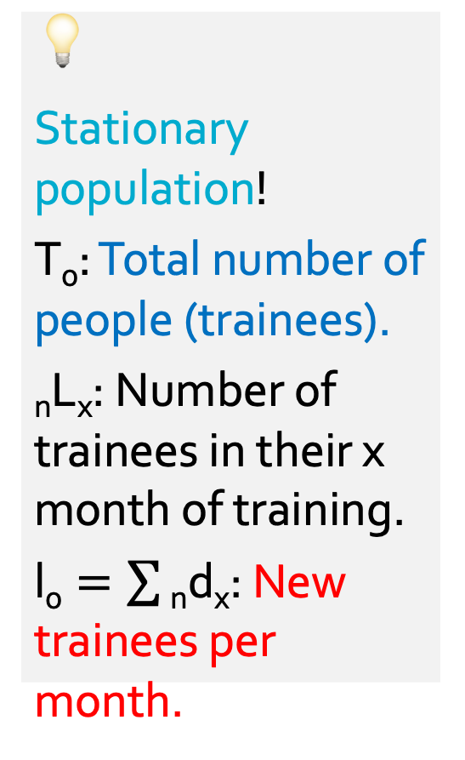
2. Application of stationary population theory
💡
Stationary population!
$\text{T}\text{0}$: Total number of people (trainees).
$\text{n}\text{L}\text{x}$: Number of trainees in their x month of training.
$\text{l}\text{0}=\sum{\text{n}\text{d}\text{x}}$: New trainees per month.
A job training program has 150 training positions that are always filled. The program admits 30 new people each month. Every month 10 people quit the program, and 20 trainees find a job. These conditions have prevailed as long as anyone can remember.

Slide 30
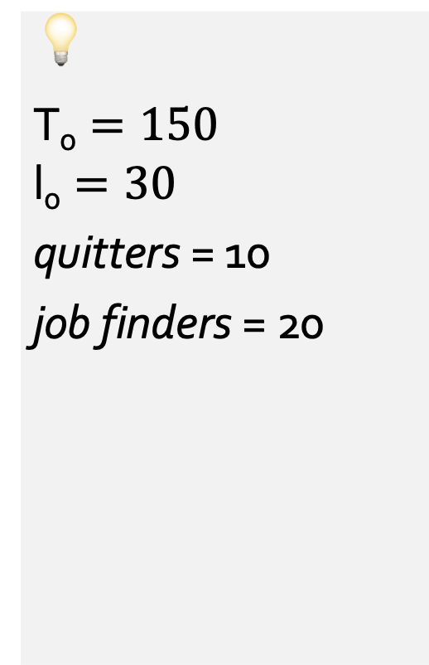
2. Application of stationary population theory
💡
$\text{T}\text{0}=150$
$$\text{l}\text{0}=30$$
quitters = 10
job finders = 20
A job training program has 150 training positions that are always filled. The program admits 30 new people each month. Every month 10 people quit the program, and 20 trainees find a job. These conditions have prevailed as long as anyone can remember.

Slide 31
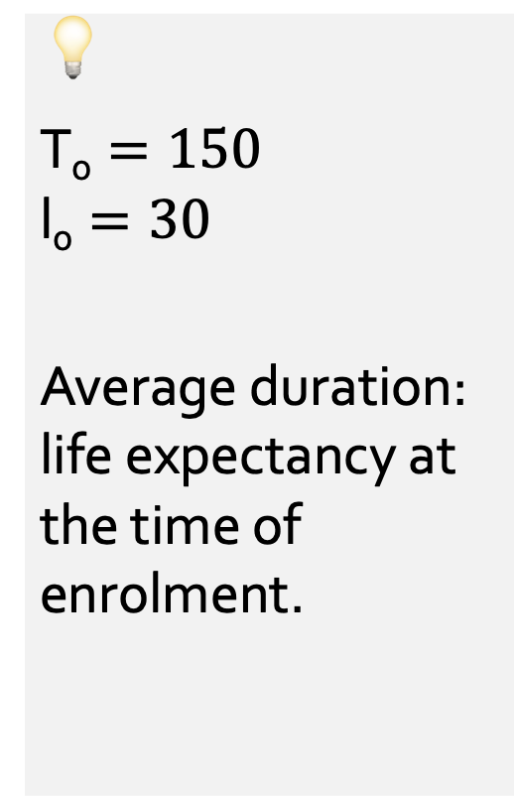
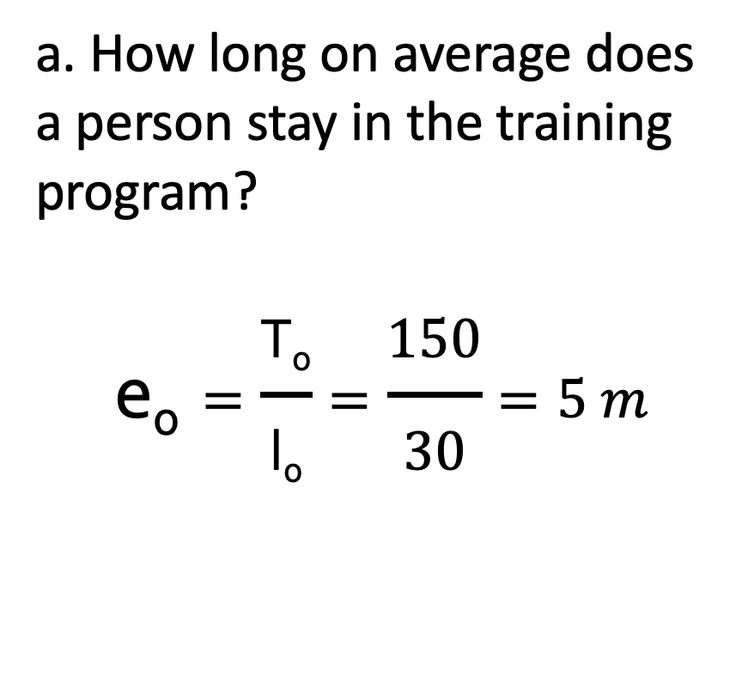
2. Application of stationary population theory
💡
$\text{T}\text{0}=150$
$$\text{l}\text{0}=30$$
Average duration: life expectancy at the time of enrolment.
a. How long on average does a person stay in the training program?
$$\text{e}\text{0}=\frac{\text{T}\text{0}}{\text{l}\text{0}}=\frac{150}{30}=5 m$$

Slide 32
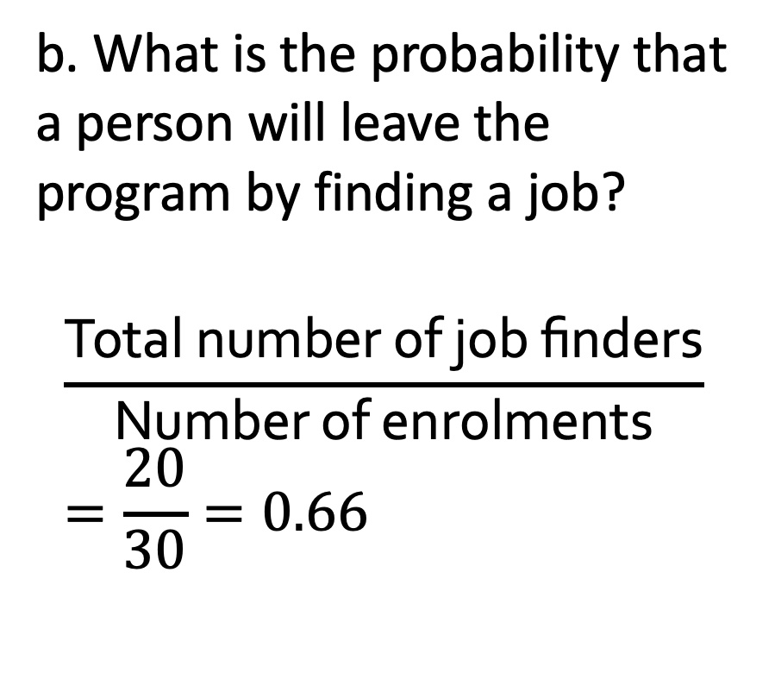
2. Application of stationary population theory
💡
$\text{T}\text{0}=150$
$$\text{l}\text{0}=30$$
quitters = 10
job finders = 20
b. What is the probability that a person will leave the program by finding a job?
$$\frac{\text{Total} \text{number} \text{of} \text{job} \text{finders}}{\text{Number} \text{of} \text{enrolments}}=\frac{20}{30}=0.66$$

Slide 33
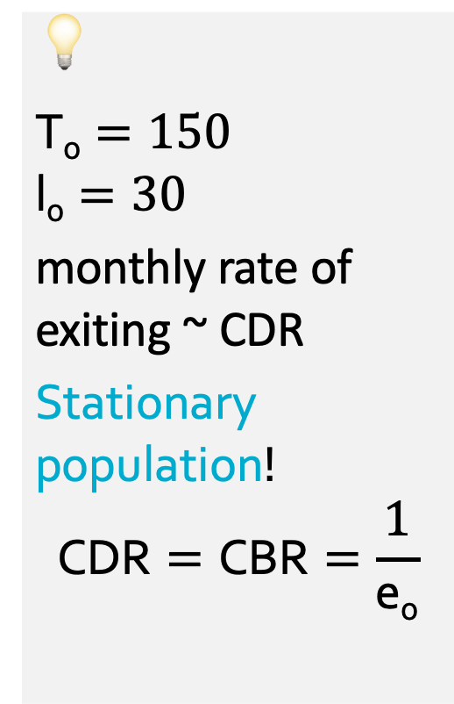
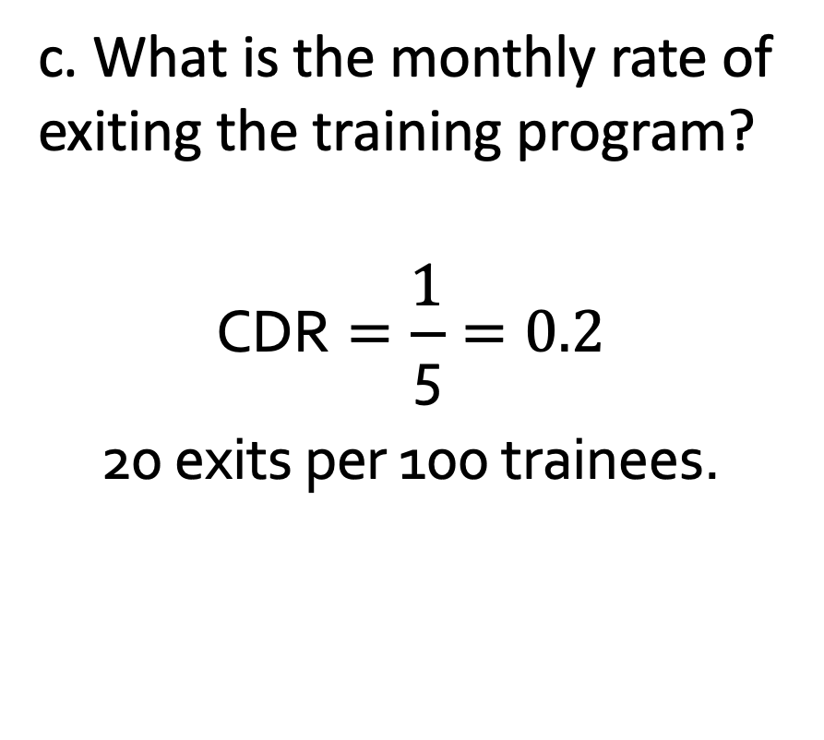
2. Application of stationary population theory
💡
$\text{T}\text{0}=150$
$$\text{l}\text{0}=30$$
monthly rate of exiting ~ CDR
Stationary population!
$$\text{CDR}=\text{CBR}=\frac{1}{\text{e}\text{0}}$$
c. What is the monthly rate of exiting the training program?
$$\text{C}\text{D}\text{R}=\frac{1}{\text{5}}=0.2$$
20 exits per 100 trainees.

Slide 34
…Thanks!

